Slide 1
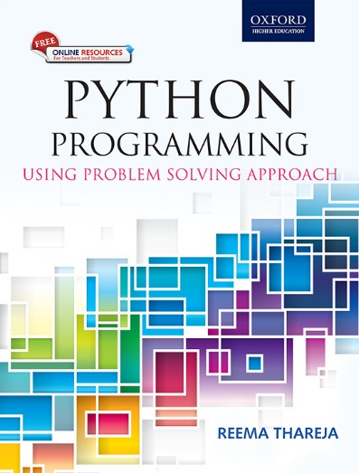
1
Python Programming
Using Problem Solving Approach
Reema Thareja

Slide 2
CHAPTER 5
Functions and Modules
© Oxford University Press 2017. All rights reserved.

Slide 3
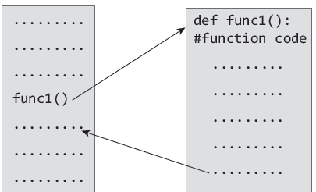
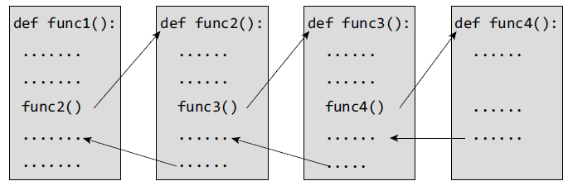
Functions
Python enables its programmers to break up a program into segments commonly known as functions, each of which can be written more or less independently of the others. Every function in the program is supposed to perform a well-defined task.
© Oxford University Press 2017. All rights reserved.

Slide 4
Need for Functions
Each function to be written and tested separately.
• Understanding, coding and testing multiple separate functions is far easier.
Without the use of any function, then there will be countless lines in the code and maintaining it will be a big mess.
• Programmers use functions without worrying about their code details. This speeds up program development, by allowing the programmer to concentrate only on the code that he has to write.
Different programmers working on that project can divide the workload by writing different functions.
• Like Python libraries, programmers can also make their functions and use them from different point in the main program or any other program that needs its functionalities.
© Oxford University Press 2017. All rights reserved.

Slide 5
Function Declaration and Definition
• A function, f that uses another function g, is known as the calling function and g is known as the called function.
• The inputs that the function takes are known as arguments/parameters.
• When a called function returns some result back to the calling function, it is said to return that result.
• The calling function may or may not pass parameters to the called function. If the called function accepts arguments, the calling function will pass parameters, else not.
• Function declaration is a declaration statement that identifies a function with its name, a list of arguments that it accepts and the type of data it returns.
• Function definition consists of a function header that identifies the function, followed by the body of the function containing the executable code for that function.

Slide 6
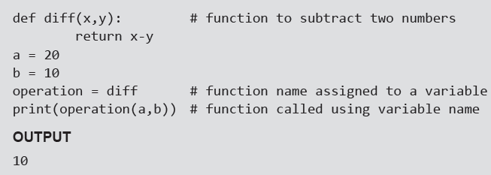
Function Definition
Function blocks starts with the keyword def.
• The keyword is followed by the function name and parentheses (( )).
• After the parentheses a colon (:) is placed.
• Parameters or arguments that the function accept are placed within parentheses.
• The first statement of a function can be an optional statement - the docstring describe what the function does.
• The code block within the function is properly indented to form the block code.
• A function may have a return[expression] statement. That is, the return statement is optional.
• You can assign the function name to a variable. Doing this will allow you to call same function using the name of that variable.
Example:

Slide 7
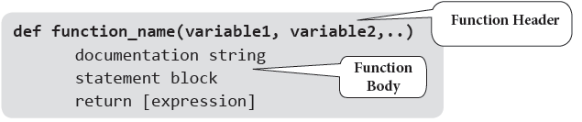
Function Call
The function call statement invokes the function. When a function is invoked the program control jumps to the called function to execute the statements that are a part of that function. Once the called function is executed, the program control passes back to the calling function.
Function Parameters
A function can take parameters which are nothing but some values that are passed to it so that the function can manipulate them to produce the desired result. These parameters are normal variables with a small difference that the values of these variables are defined (initialized) when we call the function and are then passed to the function.
Function name and the number and type of arguments in the function call must be same as that given in the function definition.
If the data type of the argument passed does not matches with that expected in function then an error is generated.
Example:

Slide 8
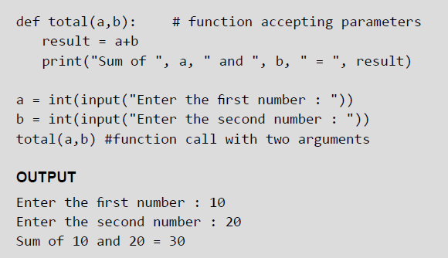
Examples

Slide 9
Local and Global Variables
A variable which is defined within a function is local to that function. A local variable can be accessed from the point of its definition until the end of the function in which it is defined. It exists as long as the function is executing. Function parameters behave like local variables in the function. Moreover, whenever we use the assignment operator (=) inside a function, a new local variable is created.
Global variables are those variables which are defined in the main body of the program file. They are visible throughout the program file. As a good programming habit, you must try to avoid the use of global variables because they may get altered by mistake and then result in erroneous output.
© Oxford University Press 2017. All rights reserved.

Slide 10
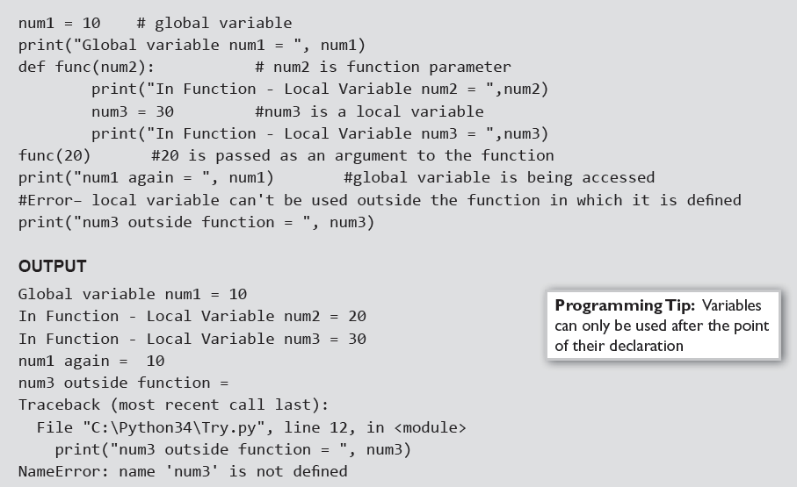
Local and Global Variables
Example:

Slide 11
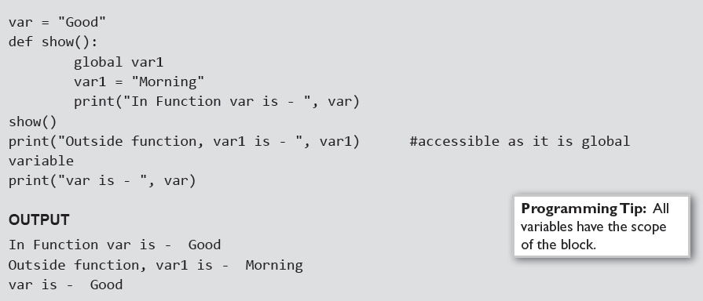
Using the Global Statement
To define a variable defined inside a function as global, you must use the global statement. This declares the local or the inner variable of the function to have module scope.
Example:
© Oxford University Press 2017. All rights reserved.

Slide 12
Resolution of names
Scope defines the visibility of a name within a block. If a local variable is defined in a block, its scope is that particular block. If it is defined in a function, then its scope is all blocks within that function.
When a variable name is used in a code block, it is resolved using the nearest enclosing scope. If no variable of that name is found, then a NameError is raised. In the code given below, str is a global string because it has been defined before calling the function.
Example:

Slide 13
The Return Statement
The syntax of return statement is,
return [expression]
The expression is written in brackets because it is optional. If the expression is present, it is evaluated and the resultant value is returned to the calling function. However, if no expression is specified then the function will return None.
The return statement is used for two things.
• Return a value to the caller
• To end and exit a function and go back to its caller
Example:
© Oxford University Press 2017. All rights reserved.

Slide 14
Required Arguments
In the required arguments, the arguments are passed to a function in correct positional order. Also, the number of arguments in the function call should exactly match with the number of arguments specified in the function definition
Examples:

Slide 15
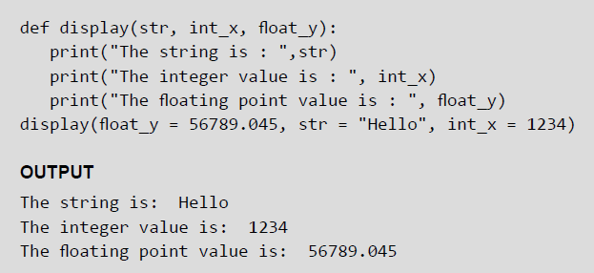
Keyword Arguments
When we call a function with some values, the values are assigned to the arguments based on their position. Python also allow functions to be called using keyword arguments in which the order (or position) of the arguments can be changed. The values are not assigned to arguments according to their position but based on their name (or keyword).
Keyword arguments are beneficial in two cases.
• First, if you skip arguments.
• Second, if in the function call you change the order of parameters.
Example:

Slide 16

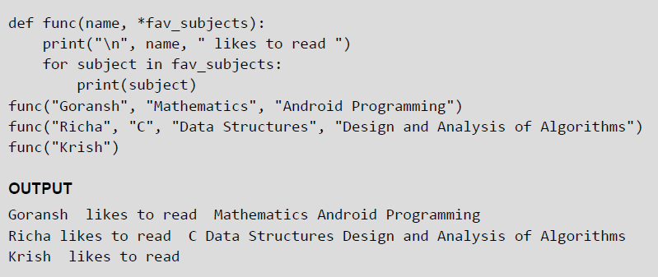
Variable-length Arguments
In some situations, it is not known in advance how many arguments will be passed to a function. In such cases, Python allows programmers to make function calls with arbitrary (or any) number of arguments.
When we use arbitrary arguments or variable length arguments, then the function definition use an asterisk (*) before the parameter name. The syntax for a function using variable arguments can be given as,
Example:

Slide 17
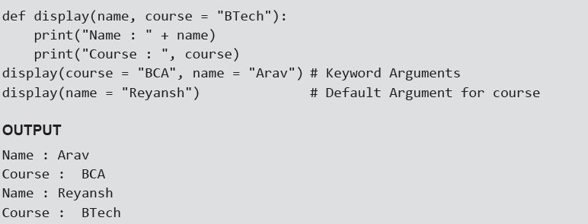
Default Arguments
Python allows users to specify function arguments that can have default values. This means that a function can be called with fewer arguments than it is defined to have. That is, if the function accepts three parameters, but function call provides only two arguments, then the third parameter will be assigned the default (already specified) value.
The default value to an argument is provided by using the assignment operator (=). Users can specify a
default value for one or more arguments.
Example:

Slide 18
Lambda Functions Or Anonymous Functions
Lambda or anonymous functions are so called because they are not declared as other functions using the def keyword. Rather, they are created using the lambda keyword. Lambda functions are throw-away functions, i.e. they are just needed where they have been created and can be used anywhere a function is required. The lambda feature was added to Python due to the demand from LISP programmers.
Lambda functions contain only a single line. Its syntax can be given as,
Example:

Slide 19
Documentation Strings
Docstrings (documentation strings) serve the same purpose as that of comments, as they are designed to explain code. However, they are more specific and have a proper syntax.
Example:

Slide 20
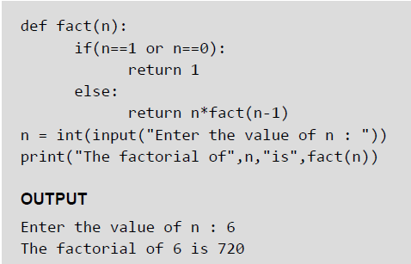
Recursive Functions
A recursive function is defined as a function that calls itself to solve a smaller version of its task until a final call is made which does not require a call to itself. Every recursive solution has two major cases, which are as follows:
• base case, in which the problem is simple enough to be solved directly without making any further calls to the same function.
• recursive case, in which first the problem at hand is divided into simpler sub parts.
Recursion utilized divide and conquer technique of problem solving.
Example:

Slide 21
The from…import Statement
A module may contain definition for many variables and functions. When you import a module, you can use any variable or function defined in that module. But if you want to use only selected variables or functions, then you can use the from...import statement. For example, in the aforementioned program you are using only the path variable in the sys module, so you could have better written from sys import path.
Example:
To import more than one item from a module, use a comma separated list. For example, to import the value of pi and sqrt() from the math module you can write,
© Oxford University Press 2017. All rights reserved.

Slide 22
Making your own Modules
Every Python program is a module, that is, every file that you save as .py extension is a module.
Examples:

Slide 23
The dir() function
dir() is a built-in function that lists the identifiers defined in a module. These identifiers may include functions, classes and variables. If no name is specified, the dir() will return the list of names defined in the current module.
Example:

Slide 24
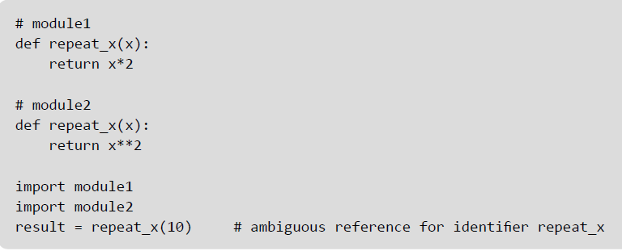
Modules and Namespaces
A namespace is a container that provides a named context for identifiers. Two identifiers with the same name in the same scope will lead to a name clash. In simple terms, Python does not allow programmers to have two different identifiers with the same name. However, in some situations we need to have same name identifiers. To cater to such situations, namespaces is the keyword. Namespaces enable programs to avoid potential name clashes by associating each identifier with the namespace from which it originates.
Example:

Slide 25
Local, Global, and Built-in Namespaces
During a program’s execution, there are three main namespaces that are referenced- the built-in namespace, the global namespace, and the local namespace. The built-in namespace, as the name suggests contains names of all the built-in functions, constants, etc that are already defined in Python. The global namespace contains identifiers of the currently executing module and the local namespace has identifiers defined in the currently executing function (if any).
When the Python interpreter sees an identifier, it first searches the local namespace, then the global namespace, and finally the built-in namespace. Therefore, if two identifiers with same name are defined in more than one of these namespaces, it becomes masked.

Slide 26
Local, Global, and Built-in Namespaces
Example:
© Oxford University Press 2017. All rights reserved.

Slide 27
Module Private Variables
In Python, all identifiers defined in a module are public by default. This means that all identifiers are accessible by any other module that imports it. But, if you want some variables or functions in a module to be privately used within the module, but not to be accessed from outside it, then you need to declare those identifiers as private.
In Python identifiers whose name starts with two underscores (__) are known as private identifiers. These identifiers can be used only within the module. In no way, they can be accessed from outside the module. Therefore, when the module is imported using the import * form modulename, all the identifiers of a module’s namespace is imported except the private ones (ones beginning with double underscores). Thus, private identifiers become inaccessible from within the importing module.

Slide 28
Packages in Python
A package is a hierarchical file directory structure that has modules and other packages within it. Like modules, you can very easily create packages in Python.
Every package in Python is a directory which must have a special file called __init__.py. This file may not even have a single line of code. It is simply added to indicate that this directory is not an ordinary directory and contains a Python package. In your programs, you can import a package in the same way as you import any module.
For example, to create a package called MyPackage, create a directory called MyPackage having the module MyModule and the __init__.py file. Now, to use MyModule in a program, you must first import it. This can be done in two ways.
import MyPackage.MyModule
or
from MyPackage import MyModule

Slide 29
Globals(), Locals(), And Reload()
The globals() and locals() functions are used to return the names in the global and local namespaces (In Python, each function, module, class, package, etc owns a “namespace” in which variable names are identified and resolved). The result of these functions is of course, dependent on the location from where they are called. For example,
If locals() is called from within a function, names that can be accessed locally from that function will be returned.
If globals() is called from within a function, all the names that can be accessed globally from that function is returned.
Reload()- When a module is imported into a program, the code in the module is executed only once. If you want to re-execute the top-level code in a module, you must use the reload() function. This function again imports a module that was previously imported.
© Oxford University Press 2017. All rights reserved.

